Slide 1
Arisetty Amruth Gmail : 17131a1233@gvpce.ac.in DOB :31/08/2000 Slack :amruth3108@gamil.com GitHub Id: GG171233

Slide 2
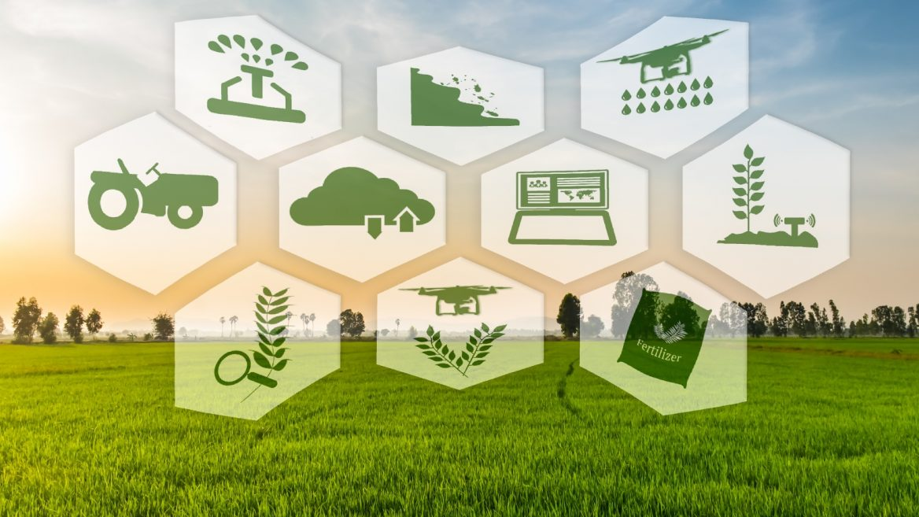




Smart Agriculture System Based On IoT
Smart Agriculture or Smart Farming is a farming management concept using modern technology to increase the quantity and quality of agricultural products.

Slide 3
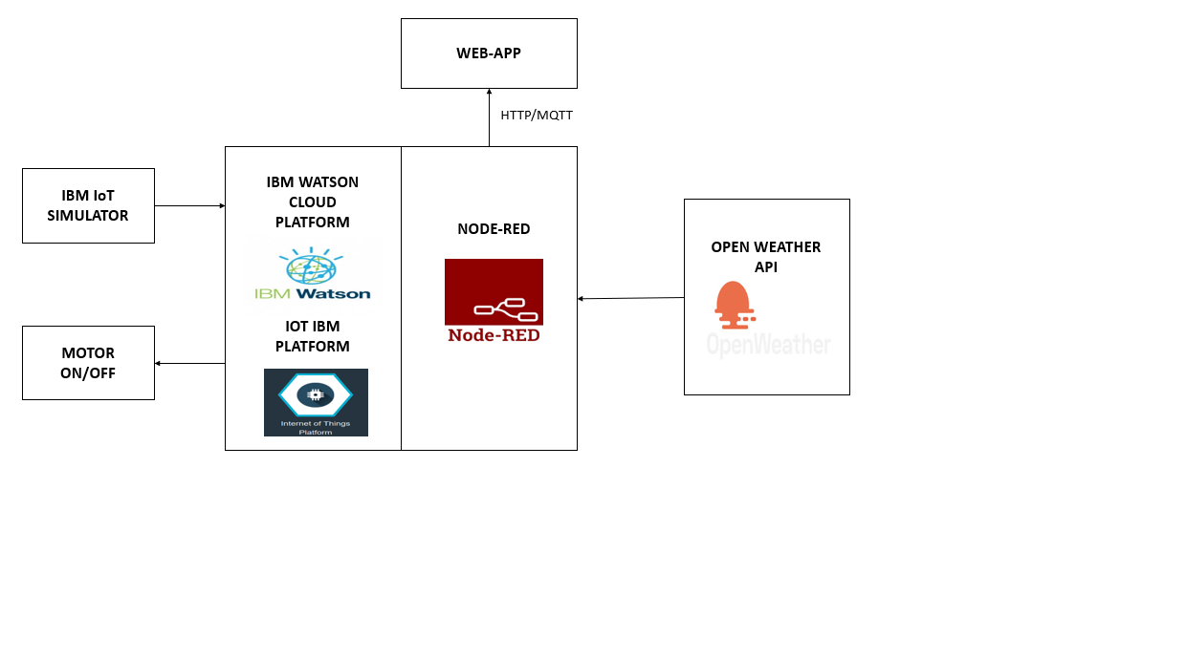
BLOCK DIAGRAM

Slide 4
Advantages of Smart Agriculture
Increases the quality of production.
Increases the quantity of production.
To reduce human efforts.
Real-Time Data and Production Insight
Improved Livestock Farming.
Remote Monitoring.
Efficient and saves time.

Slide 5
CONCLUSION
Smart agriculture System helps farmers to predict the upcoming weather forecast and prevent a lot of crop damage and loses, helps in increasing the quality and quantity of crop production and also helps in reducing few human efforts.

